Slide 1
Homework Manager System
Group leader: 刘林深
Group members: 马甜甜 许晋硕

Slide 2
Part 1 functions
administrators
students
teachers

Slide 3
Administrators
Manage students’ and teachers’ account
Delete & Add

Slide 4
Students
Manage homework status
check out homework details

Slide 5
Teachers
Publish homework details
Count the number of students who haven’t hand up homework

Slide 6
Presenting our program …

Slide 7
Part 2 designing process

Slide 8
Problems and how we solve them
1. save and manage data
2. UI
3. jumping from different UI
Use database MySQL
Use Qt
Use show / hide function （see source code）

Slide 9
process
Determine our functions
Distribute the work
Design database according to our functions
Design UI according to our functions
Design class according to our functions
Design class content
Writing source code
debug
Improve
debug

Slide 10
Part 3 classes
Addstu
Addtea
Mainwindow
Administrator
Stu
Tea
createDB
cal
Physics
·····
Hwdetail
Updatehw
addhw
Hwdetail

Slide 11
Part 4 what needs improving

Slide 12
Database
other
Code

Slide 13
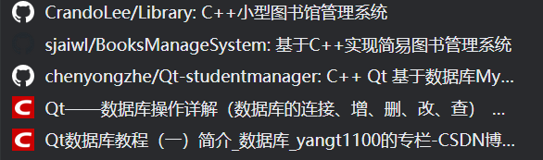
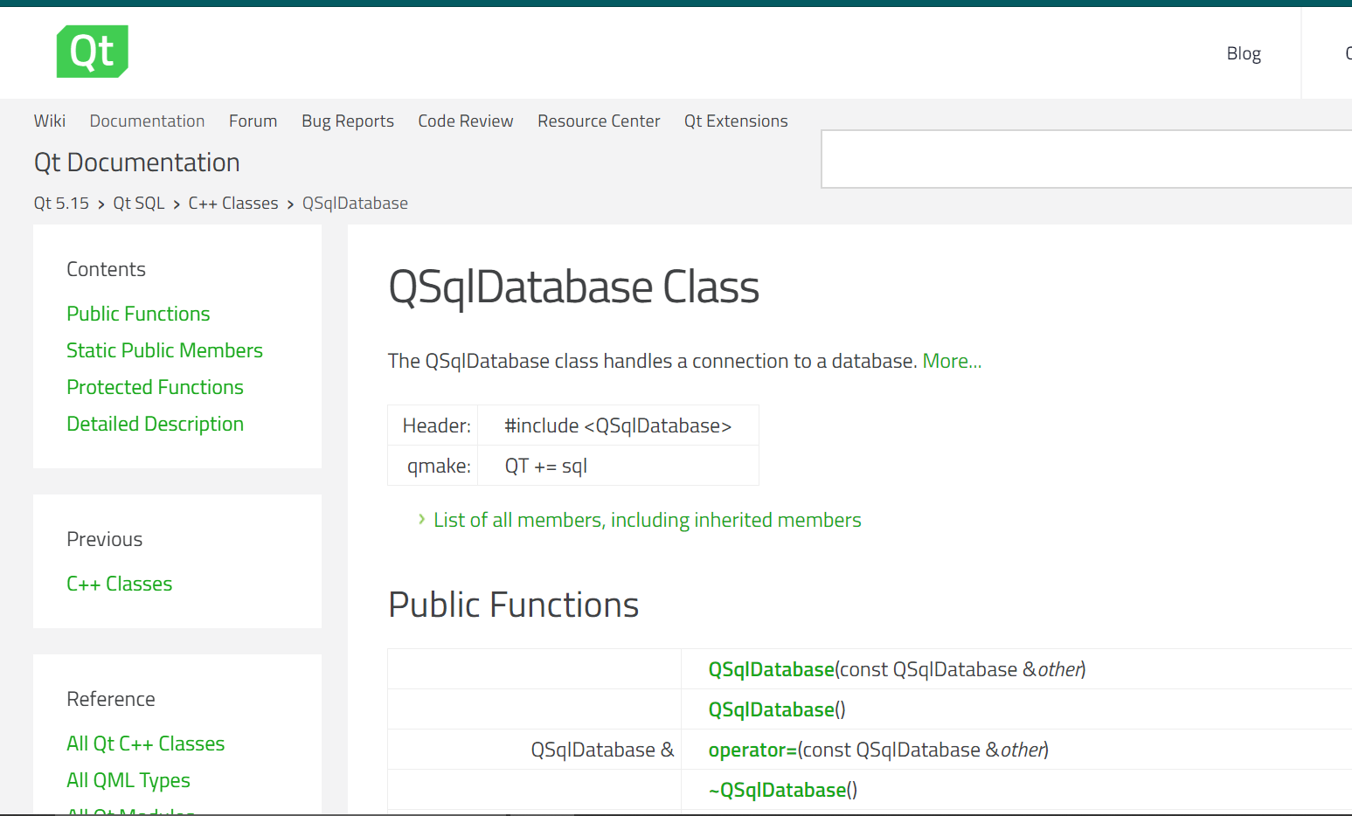
https://doc.qt.io/qt-5/
https://www.bilibili.com/video/BV1g4411H78N?from=search&seid=9322341739125360503

